Slide 1

Brittleness of ionic compounds
Aklhak Hossain
2022-3-60-057

Slide 2
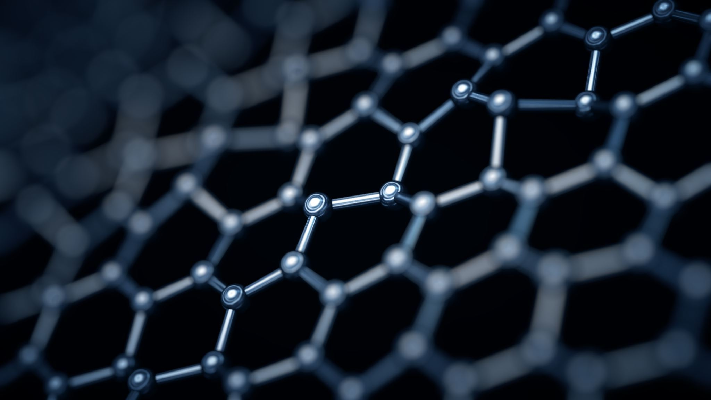
What Is Brittleness of ionic compounds?

Slide 3
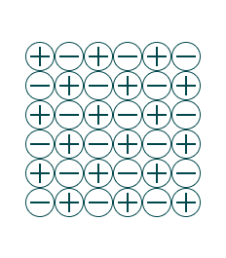
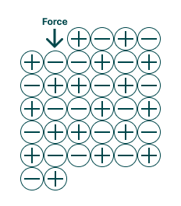
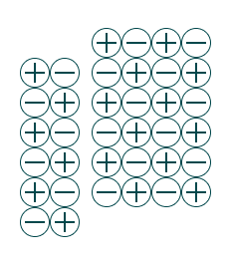

How Brittleness of Ionic Compounds works?

Slide 4
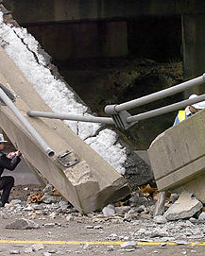
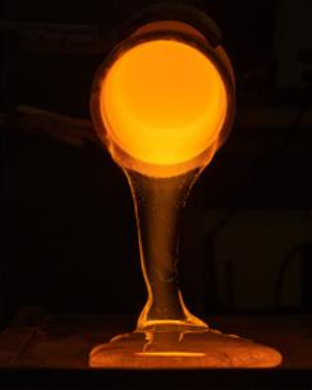
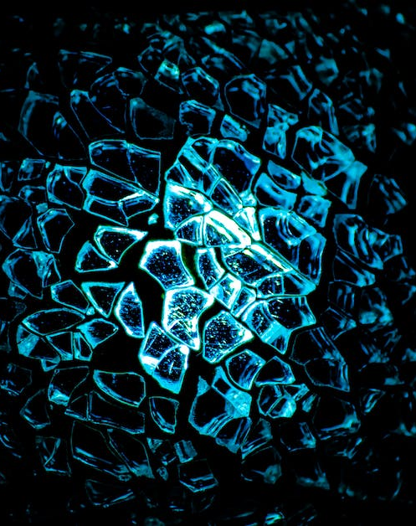

Disadvantage of Brittleness
Lack of ductility
Limited toughness
Sensitivity to temperature
Limitations in design

Slide 5


Benefit of brittleness.
This Photo by Unknown author is licensed under CC BY-NC.

Slide 6
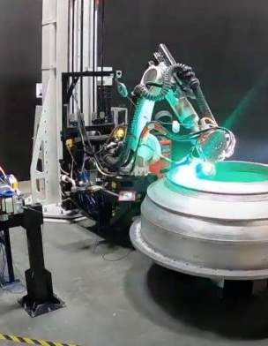

Benefit of brittleness.

Slide 7
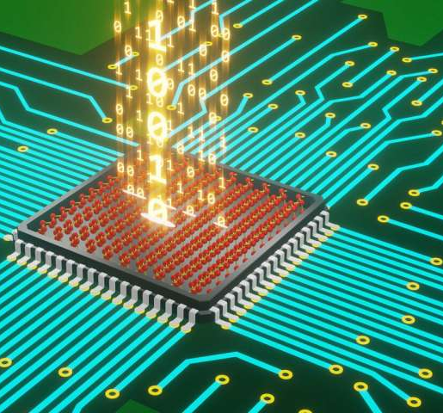
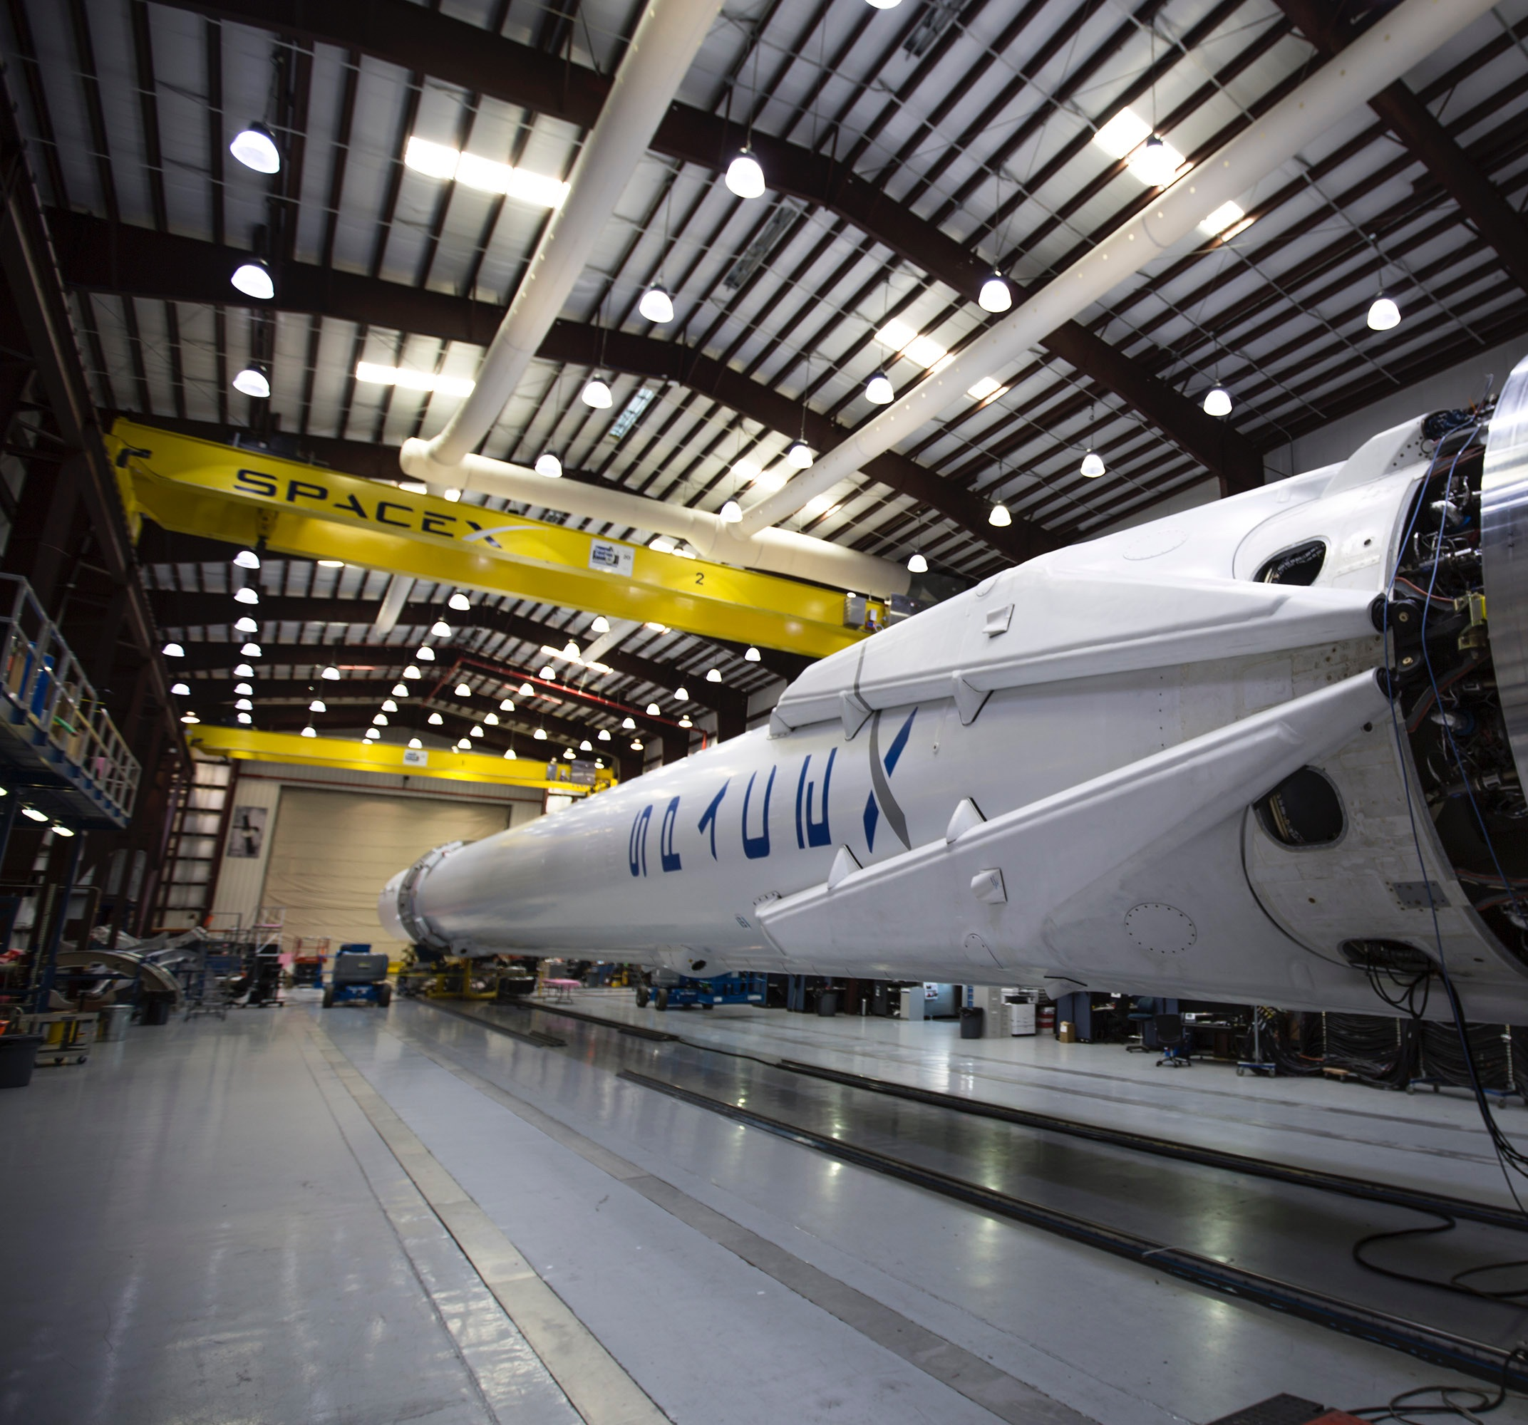
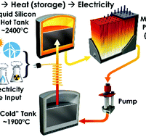
Applications of Research
This Photo by Unknown author is licensed under CC BY-SA.
This Photo by Unknown author is licensed under CC BY-NC.
Aerospace
Electronics
Energy storage

Slide 8

Thanks
Would love to answer your questions.

